Slide 1
Election and Innovation
2021 Bengal election
Mayank Mishra

Slide 2
SOLUTION OVERVIEW
Election are very uncertain but there is always a patteren and last time work of the party ,gernally there are lots of surverys happen before on the sample population to see the trend to see the result which are very close to the real result often times
We need to understand the data and make the model for each seats poltician for the final classification who will win or who will loss , basically a binary classification for each seat

Slide 3
DATA SETS USED
Data Set
District : District of Bengal Population : Population of that District Growth rate : Growth rate of the district Sex ratio : Sex ratio of that District Literacy: Literacy of that district Density per square killometer : Density of population per killometer
West bengal 2016 result analysis and Party performance
District,total number of seat and each party performances
Survey data of west bengal created by ABP news and cvoter
Goverenment data of the election
Electioon informaion by the google
https://en.wikipedia.org/wiki/West_Bengal
https://en.wikipedia.org/wiki/2016_West_Bengal_Legislative_Assembly_election
Wikipedia data
Wilkipedia 2016 result
wikipedia west bengal data
https://eci.gov.in/files/file/3195-west-bengal-2011/
Cvoter and ABP news analysis
Goveremnet information
Google Information

Slide 4




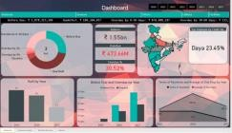


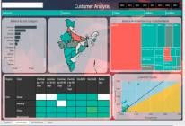
SOLUTION STACK USED
Analytics Modeling
Data
Triangulation of data from various sources
Development of Analytics Models to extract Insights
User
Data
App is visualized using leading BI platforms
<<Describe the stack used>>

Slide 5
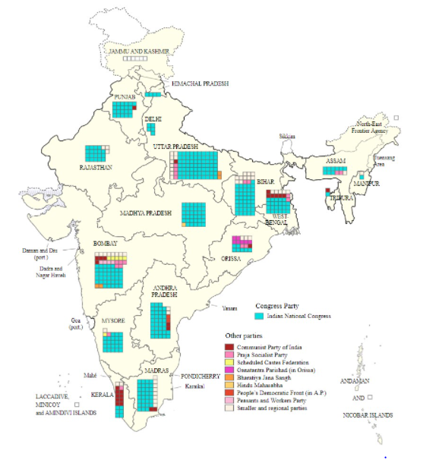
INSIGHTS INFERRED
The Indian general election of 1951–52, held from 25 October 1951 to 21 February 1952, was the first election to the Lok Sabha since India became independent in August 1947.[1][2][3] It was conducted under the provisions of the Indian Constitution, which was adopted on 26 November 1949. Elections to most of the state legislatures took place simultaneously.¶
Scrapping the data from wikipedia for the population distribution in west bengal
Source of the data is Wikipedia
Data Description
District : District of Bengal
Population : Population of that District
Growth rate : Growth rate of the district
Sex ratio : Sex ratio of that District
Literacy: Literacy of that district
Density per square killometer : Density of population per killometer
The chart is showing the literacy rate in bengal
I used lots of other from the web to understand the patteren

Slide 6
ADDITIONAL SLIDES
Election is the time when a common try to select the candidates currently with the help of Machine learning we can provide the better result based on the different survey and with past record
lots of data is currently present on the web but we need to understand what is useful and what is not we need to select the data carefully ,clean and need to make useful for the model.
The figure is Area under the curve and provide the information for true positive rate to false positive rate

Slide 7

THANK YOU!

